Slide 1


Prospectus
2023/24
opportunities for change and success

Slide 2

Useful Information
Bryn y Deryn Pupil Referral Unit
Cefn Road
CARDIFF
CF14 3HS
Telephone: 02920 529 398
Email: schooladmin@brynyderyn.cardiff.sch.uk
Website: www.brynyderynpru.co.uk
Twitter: @ByD_and_cc
Head of Centre: Miss F Simpson
1

Slide 3
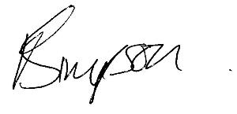
Croeso | Welcome
Dear Parents/Carers
Choosing the right school for your child is vitally important. Most parents want a good education for their children, but they also want them to be happy and to feel safe and secure. At Bryn y Deryn (ByD) we believe we can offer all these things. We pride ourselves on the education and accreditation opportunities we provide at Key Stage 4 and the high standards of teaching and learning are a credit to the hard work of both staff and learners. Equally we are also proud of the ethos and atmosphere of the school. This was celebrated in our recent excellent inspection.
Many visitors to the school comment on the warm welcome they receive and the politeness and maturity of our learners. Returned learner and parent questionnaires give very positive feedback. We do value our learners and we believe that their time in school should be rewarding and fulfilling. Should you choose to send your child to ByD, I am fully confident that you will have made the right decision. I look forward to meeting you soon and if you have any queries or concerns please contact me at school at any time.
Yours sincerely
Miss F Simpson
Head of Centre
2

Slide 4
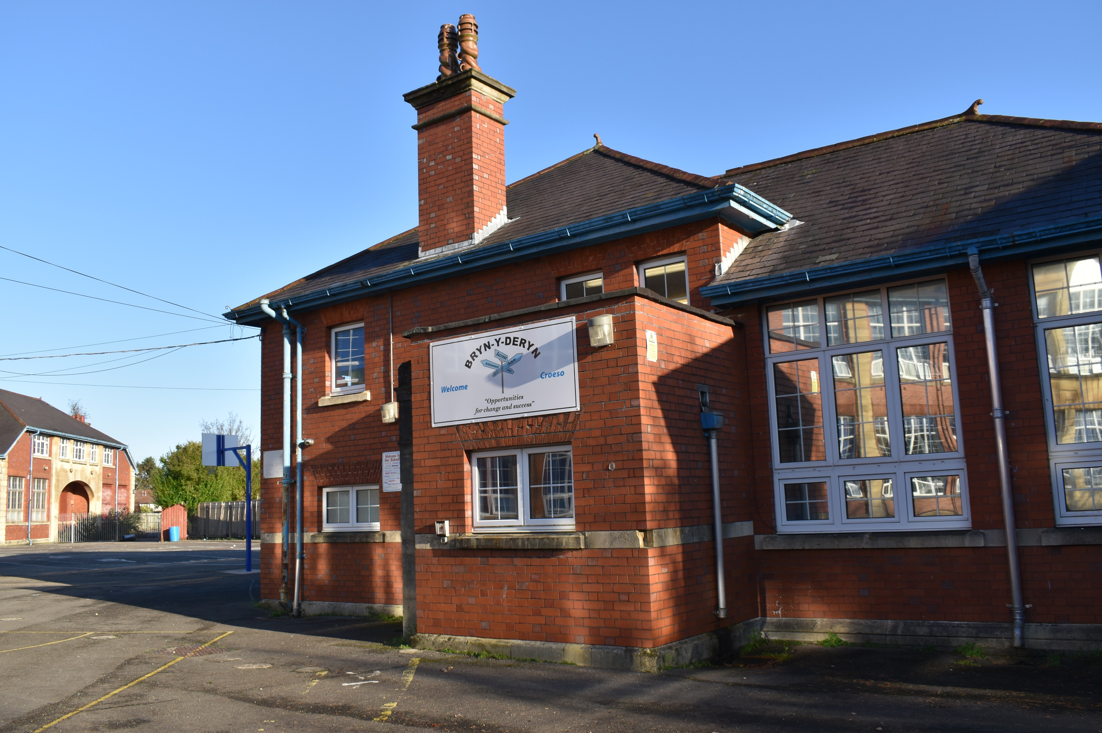
A Snapshot
Bryn y Deryn caters for learners from throughout the County of Cardiff with a capacity for 48 Key Stage 4 learners. Each class of six is taught by qualified teaching staff and is supported by a teaching assistant.
The team of teaching and non-teaching staff offer a wide range of expertise and support to learners at the centre. Staff deliver subjects at Entry Level, GCSE, BTEC and LIBF qualifications.
At ByD we are proud of the success our learners make during their time here. In the last academic year 100% of learners left with a recognised qualification. Many learners achieved Level 1 and some learners reached Level 2.
3

Slide 5
Centre Staff
Miss F Simpson Head Teacher
Mrs S Howells Deputy Head of Centre
Mrs R Mann Deputy Head of Centre
Miss K Cole Assistant Headteacher
Miss H Smith Assistant Headteacher
Mr C Palmer Assistant Headteacher
Mrs S Goodall Assistant Headteacher
Teaching Staff
Mr I Priday - Mathematics/Numeracy Teacher
Mr J Harris - Science Teacher
Miss A Malik - SWEET Teacher
Miss D Strydom - Art Teacher
Tbc - English/Media Teacher
Mr D Wearne - Photography Teacher
Mr E Benham - Food and nutrition Teacher
Teaching Assistants
A variety of teaching assistants
Support Staff
Miss M Szymanska Safeguarding Officer
Miss S Clarke Administration
Mr T Leahy ICT/Exams
School Counsellors, the School Nurse and Careers Wales staff will be available to support you too on a regular basis.
4

Slide 6
Our Aims
To enable learners to gain a greater awareness and understanding of their social, emotional and behavioural difficulties within the classroom and school environment
With guidance and support learners will be encouraged to develop positive strategies to address those difficulties and re-engage fully with the curriculum
Address specific areas of difficulty in their learning through small group and individual support
To gain relevant qualifications
To transition to a positive destination at the end of year 11
Learners’ emotional, social and behavioural needs are addressed individually within a positive behaviour support approach. We strive for an environment that builds on individual’s strengths, develops positive self-esteem, ensures equal opportunities and teaches new skills.
We promote, teach and reward our school values to support our learners in developing independence and important life skills. Individuals are supported in making positive choices for themselves and having regard for the needs of other individuals within the teaching and learning environment. Our school adopts a trauma informed approach in all its work.
Our core aims are for all learners to become:
Ambitious, capable learners who are ready to learn throughout their lives.
Enterprising, creative contributors who are ready to play a full part in life and work.
Ethical, informed citizens who are ready to be citizens of Wales and the world.
Healthy, confident individuals who are ready to lead fulfilling lives as valued members of society.
5

Slide 7
The Curriculum
ByD offers a balanced curriculum that is specifically differentiated to meet the needs of each learner. Learners follow a curriculum including Maths, English, Media Studies, SWEET, Art and Digital Photography GCSE; along with a variety of BTEC and alternative qualifications. The curriculum for Wales is embedded across the school.
Within the teaching and learning environment learners are given every encouragement to engage with the curriculum offered. In small groups, with a maximum of six learners, one teacher and a teaching assistant provide learners with the opportunity to receive the support and guidance in every aspect of their learning.
Aspects of the whole programme will focus on promoting and developing ambitious and capable learners, enterprising, creative contributors, ethical informed citizens and healthy confident individuals.
Learners will be offered five days per week at ByD. The intention is that this time will be used to gain accredited awards. Potential learners need to be aware that there is a firm expectation of good behaviour and effort.
All learners will have ongoing support from Careers Wales and youth mentors to ensure successful transition post 16. To support this work strong links also exist with a number of local colleges and other training providers in the area. Learners are given information about appropriate opportunities in the world of work.
Qualifications
Subjects
GCSE English Language
GCSE Media Studies
GCSE Mathematics
GCSE Mathematics – Numeracy
GCSE Art
GCSE Digital Photography
GCSE Science
BTEC S.W.E.E.T
GCSE Food and nutrition
Optional
Level 1 / 2 Financial Literacy
Variety of BTEC qualifications
6

Slide 8
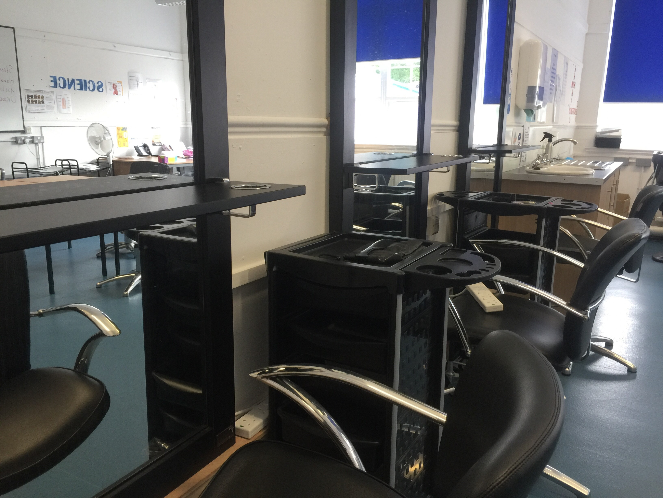

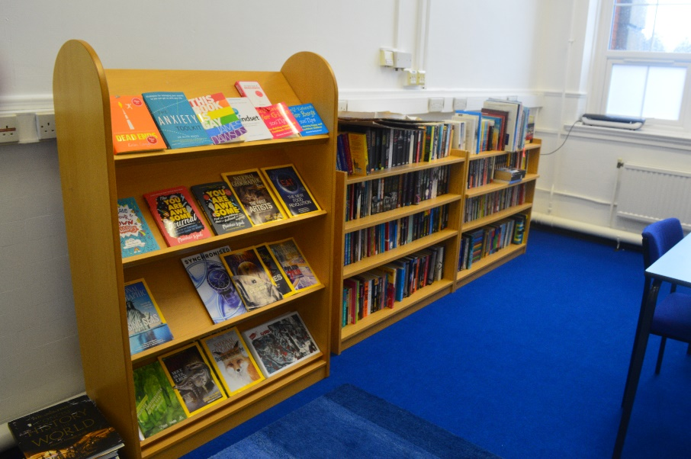
Our Facilities
At Bryn y Deryn, we have a wide range of special facilities to accommodate our learners:
Gym
Professional Hair and Beauty Salon
Pool Room
Wellbeing Room
Professional Kitchen
Trampoline
Swings
Monkey Bars
Spinners
9

Slide 9
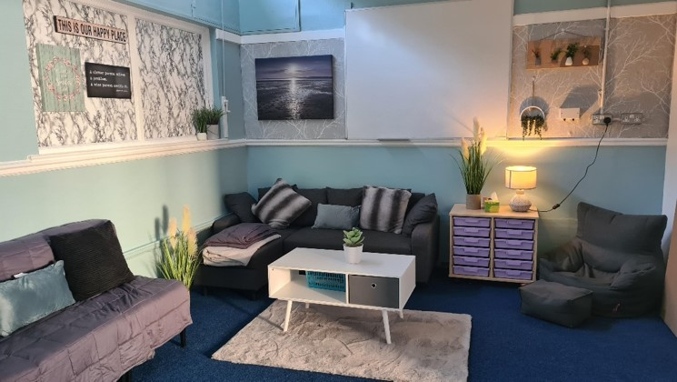
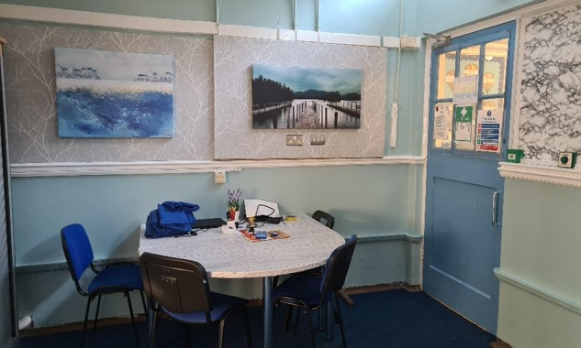
10

Slide 10
Code of Conduct
We have a high expectation of all learners who attend ByD. Learners are expected to follow and adhere to code of conduct or school rules. Learners are always encouraged to make positive choices and think through the consequences of their behaviour on their learning and the learning of others.
The following code of conduct has been established at the centre:
We arrive on time for all sessions quietly and calmly
We follow directions when asked
We keep hands, feet and objects to ourselves
We speak to each other appropriately using polite language
We remain at our workplace and on task
Attendance
There will be an induction period to help you settle in. Learners are expected to attend all aspects of their programme. The Attendance Officer or Education Welfare Officer will be notified in cases of unauthorised absence. Poor attendance may result in prosecution or loss of place. Please notify the school office by calling 02920 529 398 or emailing schooladmin@brynyderyn.cardiff.sch,uk with the name of your child, the reason for the absence and the likely duration.
Equal Opportunities
The curriculum and all aspects of school life are founded on a rejection of discrimination against learners and staff on grounds of gender, disability, race, age, sexual orientation, religion, ethnicity or culture. Each of these categories features prominently in Personal and Social Education, staff inset and assemblies. Further details are to be found in the School’s Strategic Equalities Policy.
11

Slide 11
Engagement Management
To enable learners to improve and develop positive strategies to manage their behaviour, the centre implements a system that rewards positive engagement through a system of points and commendations. During each lesson up to twenty-five points are awarded when learners demonstrate positive and appropriate engagement that adheres to the school’s code of conduct and expectations. Commendations are also given to highlight effort, encourage learners who remain on task and reward those who re-engage positively with classroom tasks after some difficulty. Certificates and prizes are awarded regularly. Parents/carers are texted daily with the learners score.
At the centre, staff acknowledge that learners who attend ByD have varying degrees of social, emotional and behavioural difficulties that impact on their learning and the learning of others. Staff will support, offer guidance and reinforce positive aspects of an individual’s behaviour. However, consequences are implemented if and when a learner repeatedly demonstrates inappropriate behaviour.
Consequences can include loss of rewards, period of reflection away from peers, telephone calls to parents, during school or after school reflection, warning letter home and more serious cases may result in a fixed-term exclusion being imposed.
Additional Learning Needs
The Additional Learning Needs (ALN) policy is part of the school’s commitment to inclusion for all. Learners are at school action plus under the code of practice and some are statemented. All learners have access to the broadest curriculum possible.
ByD will identify where learners have barriers to learning which are hampering access to the curriculum and will provide additional support tailored to their individual needs. Intervention and support are given to ensure learners with ALN achieve their maximum potential.
12

Slide 12
Example Timetable
Here is how the school day will look:
13

Slide 13

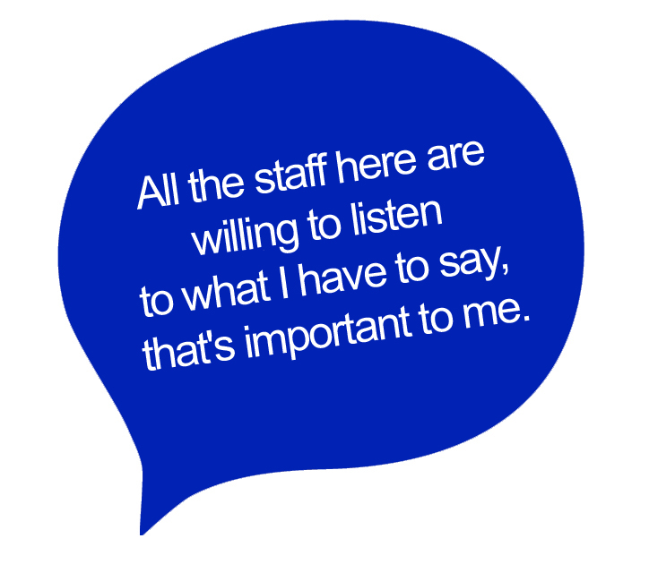

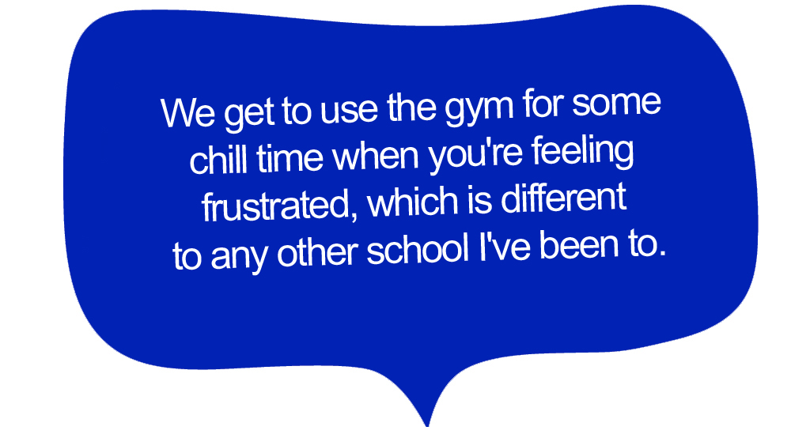

Learner Thoughts
Hear what our learners say about Bryn y Deryn.
14

Slide 14
Further Information
Bullying
Bullying will not be tolerated at ByD. Learners are encouraged to report any incidences of bullying that may occur at the centre. Each incident will be investigated thoroughly and measures implemented to resolve matters quickly.
Dangerous Substances, Materials and Objects
Substances such as drugs, hazardous materials or dangerous objects will be treated as a police matter and will be dealt with accordingly and may include permanent exclusion. Referrals to support agencies may be made.
Personal Equipment
Learners are not allowed to use mobile phone in lessons as they can be a distraction. They can be used during break and lunchtimes.
Collective Worship
Class based collective worship will take place in a variety of forms every day. Parents/Guardians have the option to withdraw learners from collective worship and have the right to see the collective worship policy.
Charging and Remissions Policy
ByD acknowledges the right of every person to receive free school education and understands that activities offered wholly or mainly during normal teaching time must be made available to all young people regardless of their parents’ ability or willingness to help meet the cost.
ByD will not charge for activities offered, although parents may be asked to contribute towards any damage made by their child to school property.
15

Slide 15
School Day
The day begins at 08:45 and ends at 14:30. Free toast, bagels, juice and fruit are provided between 08:45-09:15.
Lunchtimes
Learners are not permitted to leave the site during the morning or lunch break. Please only provide your child with sugar free drinks (non-fizzy/no energy drinks) and healthy snacks.
Uniform
Currently, learners do not wear a uniform. We encourage learners to wear school-appropriate clothing.
Transport
Transport will be provided to ensure your child is able to attend the centre. This is a privilege and can be withdrawn if necessary. A taxi will collect your child from home at the start of the day and take them back at the end of the day.
Visiting school, traffic and school security
You are always welcome to visit school by appointment. We ask a few things of parents when you visit school:
As with all visitors, please report to school reception where you will be registered into school.
Whenever parents/carers collect their children from school, please ensure that you have informed the school office that you will be taking them offsite (and when/ if they will return). NB. Please do not be offended if members of staff wish to check your identity. They will always be acting in your child’s best interests.
Likewise, please bring learners who are late or are returning from appointments to the school office where arrangements will be made for them to re-join their classes.
Fire Drill
In the event of a fire (or a drill), learners and accompanying staff will leave the building via the nearest exit and assemble in the yard.
16

Slide 16
Positive Handling
All staff at the school are fully trained in the Team Teach approach in managing difficult behaviour. The training is focused on applying a comprehensive range of de-escalation strategies that are aimed to diffuse difficult and challenging situations. However, in some circumstances a pupil’s behaviour may reach levels that compromise the health and safety of staff and other learners. In such circumstances, parents/carers will be notified. Staff follow strict guidelines when recording and reporting any positive handling situations.
Child Protection/Safeguarding
Miss Simpson, Head of Centre, has overall responsibility for these matters as well as children who are looked after. The school has a safeguarding team which also includes Miss Howells, Acting Deputy Head of Centre and Miss Szymanska, Safeguarding Officer.
Our school also has a nominated child protection management committee member, Ann Cook, who ensures that the school has a child protection policy in place that is consistent with the All Wales Child Protection Procedures (2008).
Links with Parents / Carers
We aim to have good communication with parents/carers. Important information is circulated by email or text to parents and information is also available on the school website. Parents/carers are responsible for ensuring the school has up to date contact details in case of emergency. Parents are invited to school to join us for particular events and festivals throughout the year as well as for celebrations. You will have a weekly call from a dedicated member of staff.
Parents are welcome to contact the school to discuss their child’s progress or any concerns they may have, as soon as possible, at a mutually convenient time.
We ask that parents / carers are patient and polite in all their communications with the school.
17

Slide 17
Term Dates
Autumn Term 1
Monday 4th September 2023 | First day of term
Friday 27th October 2023 | Last day of term
Autumn Term 2
Monday 6th November 2023 | First day of term
Friday 22nd December 2023 | Last day of term
Spring Term 1
Monday 8th January 2024 | First day of term
Friday 9th February 2024 | Last day of term
Spring Term 2
Monday 19th February 2024 | First day of term
Friday 22nd March 2024 | Last day of term
Summer Term 1
Monday 8th April 2024 | First day of term
Friday 24th May 2024 | Last day of term
Summer Term 2
Monday 3rd June 2024 | First day of term
Friday 19th July 2024 | Last day of term
18

Slide 18
Bryn y Deryn Pupil Referral Unit
Cefn Road
CARDIFF
CF14 3HS
02920 529 398
schooladmin@brynyderyn.cardiff.sch.uk
www.brynyderynpru.co.uk
@ByD_and_cc

